Slide 1
Random Effect Misspecification in Stepped Wedge Designs
Emily Voldal, Jim Hughes
13th Annual Conference on statistical Issues in Clinical Trials
April 12, 2021
Joint with Patrick Heagerty, Fan Xia, Avi Kenny

Slide 2
The stepped wedge design
Cluster | Time
1
2
3
4
5
6
Intervention
Control
Phased implementation, all clusters receive intervention eventually
Clusters are randomized as to when intervention is received
Typically, measure outcome on each cluster, at each time step
Notes:
6 sequences, 1 cluster per sequence, 7 time periods

Slide 3
The stepped wedge design
Time in NOT balanced between intervention and control periods
Intentional confounding of time and treatment must be resolved using e.g. regression analysis
Correlated data due to clustering
Notes:
Cook and Campbell – “Experimentally Staged Introduction”
Note issue of healthy survivor bias if cohorts are followed
Outcome usually measured at time of stepping but maybe not in IRT

Slide 4
LMM framework
Y_{ijk} = μ + β_{j} + X_{ij}θ + a_{i} + b_{ij} + X_{ij}c_{i} + e_{ijk}
a_{i} ~ N(0,τ²) – variation in mean
b_{ij} ~ N(0, γ²) – variation in time effect
c_{i} ~ N(0,η²) – variation in tx effect
e_{ijk} ~ N(0,σ²) – random variation
Assuming cross-sectional sampling at each time
Notes:
Model is for a continuous outcome; ideas extend to binary measures
Model for cross-sectional measurements (no person level random effect)

Slide 5
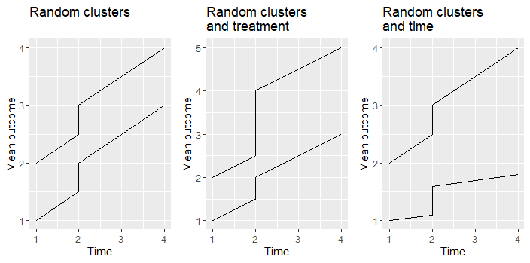
Random effects
Notes:
Two clusters with intervention turned on at time 2

Slide 6
LMM framework
cluster
treatment
time
Y_{ijk} = μ + β_{j} + X_{ij}θ + a_{i} + b_{ij} + X_{ij}c_{i} + e_{ijk}
For cross-sectional SWTs, three commonly considered random effects are cluster, time, and treatment
Do all random effects need to be included?
Is there “collinearity” between random effects for time and treatment?

Slide 7
Random effects
Best practice is to use a full random effects model
Sometimes that model will not converge because of over-parameterization
How to choose between random effects for time and treatment?
Scientific justification
Prior work in the area
Does it matter? What is the impact on inference if one chooses incorrectly?

Slide 8
Mis-specification scenarios
Case 1: True treatment, fit time
Case 2: True time, fit treatment

Slide 9
Convergence under mis-specification
Key idea: Under mis-specification the MLE minimizes the Kullback-Leibler divergence; converges to the roots of
$$E_{α_{t}} \left[\frac{∂}{∂α}\log{p_{α}\left(Y | X\right)|_{α^{∗}}}\right]=0$$
Fixed effect estimates are unbiased
For each case, there are four roots:
All variance components nonzero
No random effects
Only random cluster effect
Only random time (case 1) or treatment (case 2)
Notes:
Closed form solutions of roots derived
In simulated data, root one most common, especially as sample size increased

Slide 10
Variance of treatment effect estimate
Define two measures of the effect of mis-specification:
Validity = $\frac{\text{Model}\text{−}\text{based} \text{variance} \text{with} \text{mis}\text{−}\text{specified} \text{model}}{\text{True} \text{mis}\text{−}\text{specified} \text{model} \text{variance}}$
Efficiency = $\frac{\text{Model}\text{−}\text{based} \text{variance} \text{with} \text{correctly} \text{specified} \text{model}}{\text{True} \text{mis}\text{−}\text{specified} \text{model} \text{variance} }$
Notes:
Focus on root 1 – most interesting and most prevalent
True mis-specified model variance based on a sandwich estimate
Validity > 1 conservative; Validity < 1 too liberal (inflated type I error rate)
Efficiency <= 1 always

Slide 11
Validity
O X X
O O X
Notes:
Results for root 1
Validity (mis-specified model var/true mis-specified model var) for typical set of variance components.

Slide 12
Validity
% cluster var from mis-specified effect
10%
50%
90%
*Average cluster correlation – extension of intra-cluster correlation
Notes:
Validity worsens as ACC* increases or as the excluded random effect becomes more influential.

Slide 13
Efficiency
% cluster var from mis-specified effect
10%
50%
90%
Notes:
For small ACC or small excluded random effect (solid line), not much efficiency is lost by choosing the wrong model.

Slide 14
Example
Effect of removing weekend services from hospital ward
Outcome is log(length hospital stay)
Six sequences, 2 wards/sequence, mean 177 obs/ward/period
Full model does not converge
 | $$\hat{θ}$$ | $$se(\hat{θ})$$ | SD_{time} | SD_{treat}
Fit random time | 0.13 | 0.05 | 0.12 | --
Fit random treat | 0.10 | 0.04 | -- | 0.10
Notes:
Is one approach more robust?
How far wrong might we be if we fit wrong model?

Slide 15
Example

Slide 16
Conclusions - Model mis-specification
Can quickly calculate efficiency and validity without simulations
Help choose a model when there are convergence issues
Quantify concerns about fitting a mis-specified model
Choice of fitting random time or treatment matters
No universal recommendation regarding most robust approach
Designs with 2 or 3 sequences – fitting random time safer than random treatment
Use full model and/or robust variances when possible

