Slide 1
Deborah Donnell Fred Hutchinson Cancer Research Center 13th Annual Conference on Statistical Issues in Clinical Trials Center for Clinical Epidemiology and Biostatistics April 12, 2021 (Virtual)
Challenges in Implementing CRTs: from Hawthorne Effect to Measurement Bias

Slide 2
Lessons learned from three different cluster randomized trials
Notes:
I have had the privilege of working on three very large CRTs in HIV prevention. Each spanned many years of planning, execution and analysis. It is lovely to have the opportunity to talk about some of the practical happenstance circumstances of these challenging projects.

Slide 3
Design and Evaluation features
How is the intervention implemented and delivered?
Cluster randomized implies intervention implemented or delivered to an entire (target group in a) cluster
Who receives the intervention?
High coverage important for impact
Who benefits from the intervention?
Defines options for measuring impact
Evaluation of intervention impact
Randomization
Evaluation plan
Evaluation realities
Cluster
Intervention Target
Intervention Coverage
Benefit
Notes:
I am going to start by describing each of these trials, using that peculiar statistical lens of statisticians, focused on what is the primary question (intervention and intended effect); how do we measure its effect.
Each trial also had vibrant social science and community engagement teams that were critical to trial execution: not included in this presentation.
Who benefits? Common that the intervention is expected to have benefit beyond those directly getting it. But can be targeted at the individual – only those who get the intervention benefit.
Dilemma: If benefit is broader than direct, true cluster impact measure broader. However much less expensive to evaluate impact in those getting intervention
Illustrate and justify the choices that were made for

Slide 4
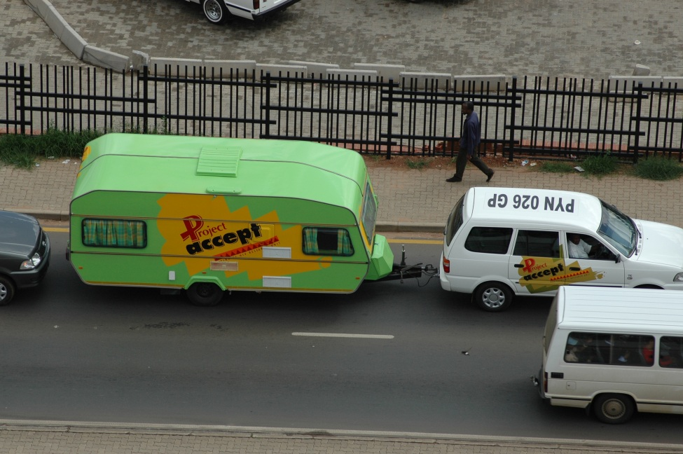
HPTN 043: Project Accept (2001 – 2011)
Impact of Mobilized HIV Testing, Support, and Access to Services on HIV incidence
Community-based VCT
(N = 24 communities)
Standard VCT
(N = 24 communities)
Community preparation, outreach
Mobile VCT: 36 months
Post-test support services
Stigma-reduction skills training
Coping effectiveness training
Ongoing counseling
Clinic-based VCT
Standard VCT services provided in that community
Four peri-urban locations: 34 communities
Tanzania: 5 pairs Zimbabwe: 4 pairs
Vulindlela, S Africa: 4 pairs
Soweto, S Africa: 4 pairs
Van Rooyen et al, AIDS and Behavior, 2012
Sweat et al, Lancet HIV, 2011
Notes:
Before TasP and PrEP.
Community size 3,000-30,000
3 years of implementation

Slide 5
Project Accept : Primary result – Change in Incidence
Evaluated HIV in ~46,000 individuals ages 18-32
Risk of recent infection reduced by 14% (95%CI $−$0.2%-0.27)
p = 0.08
Coates et al, Lancet HIV, 2014
Notes:
Turn to the last page in the book:
Paired (weighted) t-test. More than 90% power to detect 35% reduction in incidence. 900-1300 per community
Colors are countries.

Slide 6
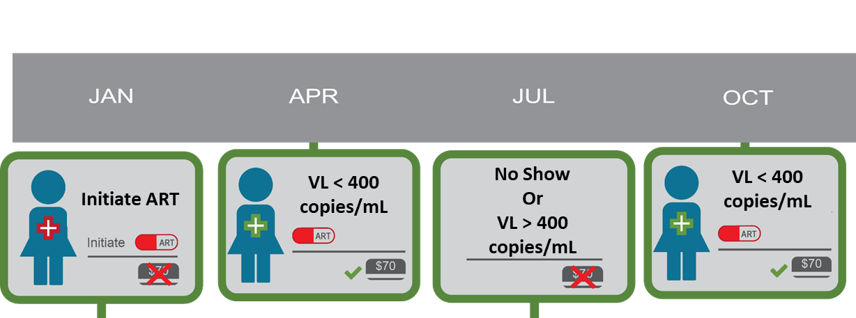
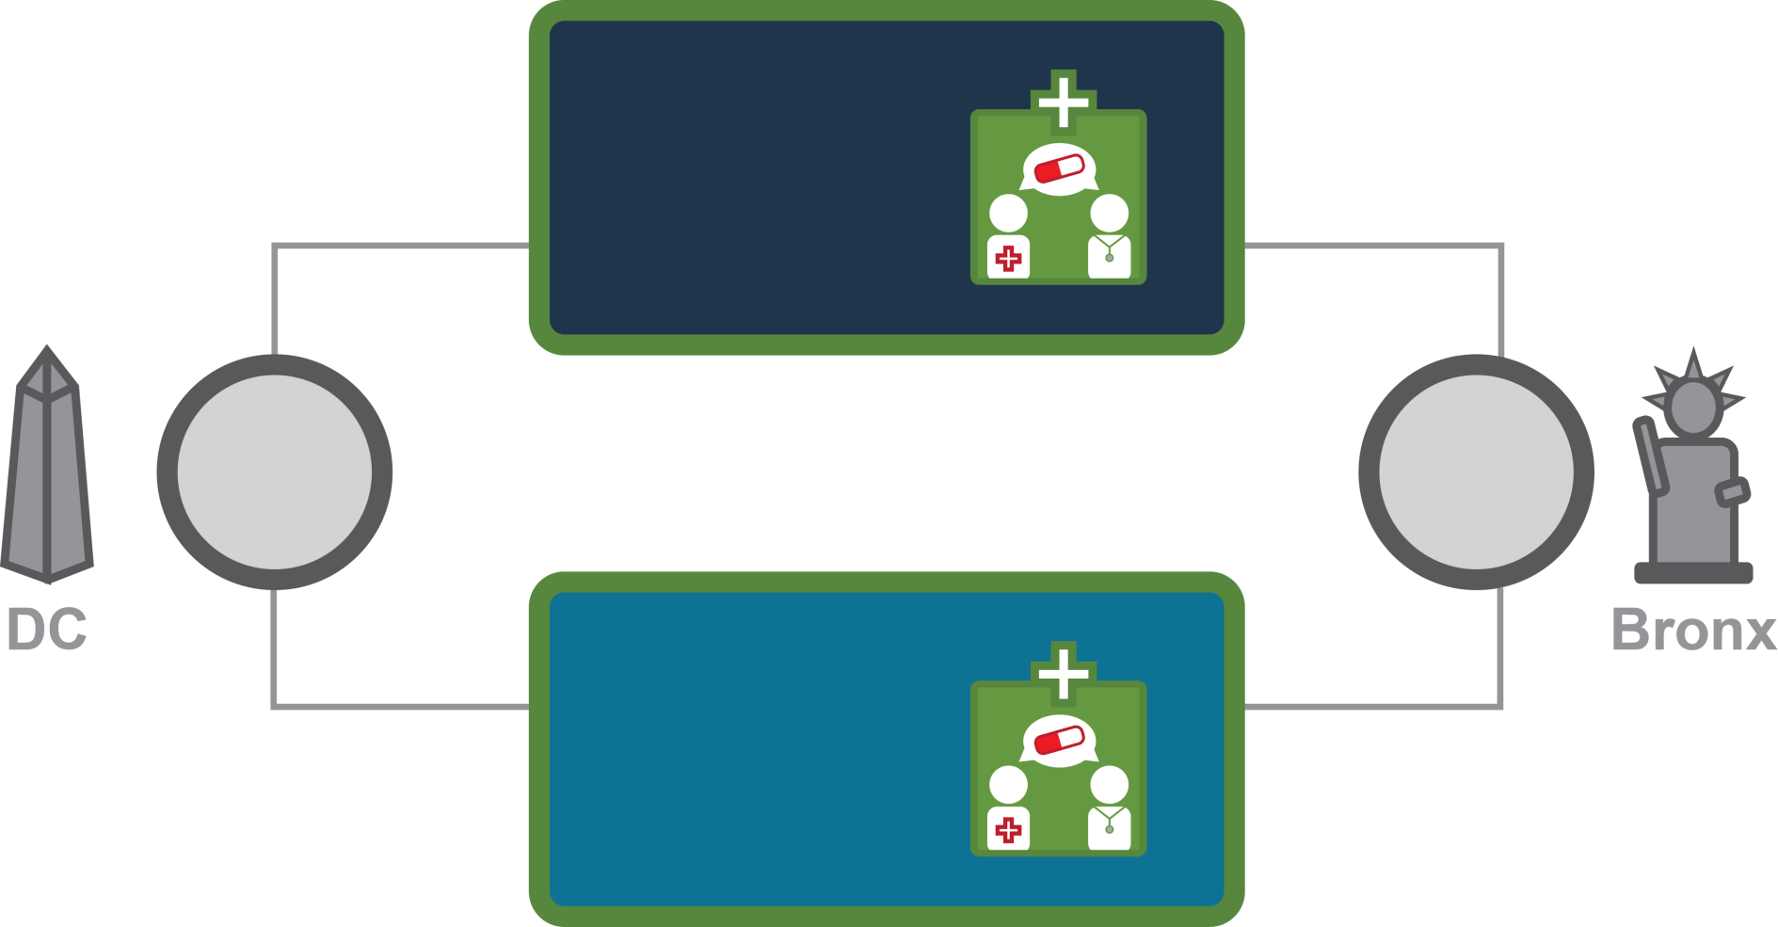
HPTN 065: TLC-Plus (2010-2013)
FINANCIAL INCENTIVES
Financial incentives offered for 2 years.
Impact of Financial Incentives on Viral Suppression amongst PLWH
19
9
10
Care Sites
HIV test site randomization balanced by:
Size of HIV care site’s HIV-positive patient case load
Proportion of HIV-positive patients with VL suppression at baseline
19
20
10
10
19 Sites Washington D.C.
Care Sites
20 Sites
NYC
STANDARD OF CARE
Notes:
On the heels of TasP (2011).
Individual intervention: cluster randomized. “Program implementation”. Too disruptive to clini operations to do individual randomization.
Working with clinics serving persons living with HIV: patient population ranged from 200 to 2000+
Financial incentives offered for 2 years.

Slide 7
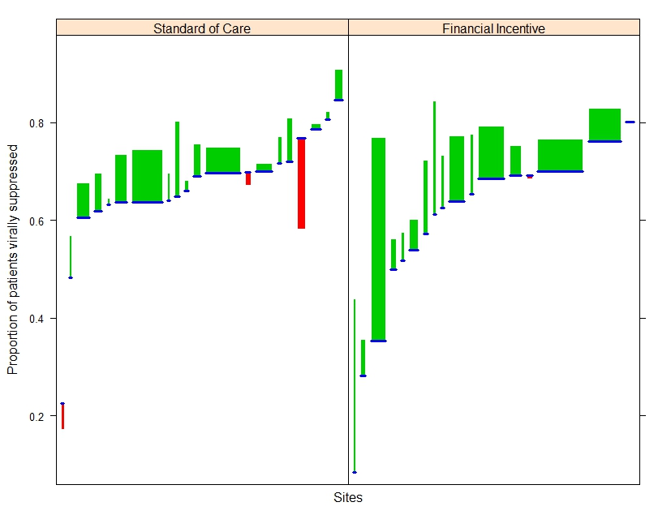
TLC-Plus: Primary result - Change in Viral Suppression
Average patients in care per site = 500
Increase in probability of viral suppression
FI vs SOC = 3.8% (95%CI: 0.7%, 6.8%)
p = 0.01
Blue line : Baseline Viral Suppression
Green = increase, red = decrease in viral suppression
Width = population size
Sites within each arm ordered by baseline VS
El Sadr Jet al, AMA 2017
Notes:
Evaluation period: beginning 9 months after FU began: 15 months of evaluation

Slide 8
HPTN 071: PopART (2012 – 2018)
Impact of Household-based Universal HIV Testing and Universal ART on HIV incidence
21 Communities
7 per arm in matched triplets
Arm A
Arm B
Arm C
+ Universal ART
+ SOC ART
+ SOC ART
+ SOC HIV Test
12 in Zambia
9 in S Africa
3 years of intervention
Notes:
Based on TasP
Intervention implementation: Delivered to all adults in communities, through household based testing; repeated at least annually for three years
Target of intervention: Primary mechanism is TasP – target is HIV+ individuals, especially those virally unsuppressed
Benefit of intervention: Reduced risk of HIV infection in HIV-uninfected; increased viral suppression in HIV-infected
85% power to detect 40% reduction in incidence

Slide 9
PopART : Primary result – Impact on HIV incidence
3
7% reduction
p = 0.51
3
30% reduction
p = 0.006
Incidence (per 100 Person-Years)
Measured HIV in cohort of 48,000 participants
5
4
6
5
4
6
5
2
4
2
5
1
2
3
2
3
2
6
3
3
6
2
4
1
1
1
1
1
7
7
7
7
0
0
Arm A
Arm C
Arm B
Arm C
Z Triplet 1
SA Triplet 5
Z Triplet 2
SA Triplet 6
Z Triplet 3
SA Triplet 7
Z Triplet 4
10 20
30 40
Hayes, NEJM 2019
Triplets
Events
Notes:
VS compared to Arm C
16% increase P value = 0.07
8% increase P value = 0.30

Slide 10
Design of intervention evaluation

Slide 11
Randomization: De-risking between cluster variance
Four different settings in three countries
38 communities (17 pairs)
Randomization method
Paired communities within each location
“based on socio-demographic, cultural, and infrastructure characteristics determined from formative research”
Chirowodza J Community Psychol. 2009
Random allocation within each pair (unrestricted)
Matching: 17 vs 38 observations
Multiple settings in two countries
21 communities (7 triplets)
Randomization method
Triplets grouped by location
Random allocation of arms within triplet
Restricted randomization to balance:
Size of community (intervention delivery)
HIV prevalence (incidence correlate)
ART uptake (intervention baseline)
Among all possible allocations select 5000 with best balance by arm; select 1 at random
Multiple clinics in two cities
39 clinics
Randomization method
Unmatched
Stratified by city
1:1 randomization within each city
Restricted randomization to balance:
Clinic patient volume
Baseline proportion clinic patients virally suppressed
Among all possible allocation select 10,000 with best balance; select 1 at random
Notes:
Commonalities: Broad geographic spread – matching used
Small number of communites/ no matching: control to avoid “bad” randomizations of factors impacting outcome (size; baseline intervention; baseline outcome)
Restricted randomization: permutation test
PopART: Community randomization ceremony

Slide 12
Intervention intended mechanisms: primary outcome
Intervention implementation :
HIV testing in the community using mobile vans
Post test support
Intervention goal and coverage
Increase knowledge of HIV in all adults
Coverage: all adults who accept test
Impact goal
Fewer infections in HIV uninfected
Primary Outcome
HIV incidence in 18-32 year olds
Intervention implementation:
Household based implementation of universal HIV testing for all adults in the community
HIV positive linked to ART at clinic
Intervention goal and coverage
Increase knowledge of HIV-infected in all adults
All HIV-infected on treatment
Coverage: All (HIV+) adults reached
Impact goal
Fewer infections in HIV uninfected
HIgher viral suppression in HIV+
Primary outcome
HIV incidence in 18-44 year olds
Viral suppression in HIV-infected
Intervention implementation
Clinics implement financial incentives
Individuals receive quarterly financial incentive if virally suppressed
Uptake goal
All HIV-infected patients in care
Coverage: HIV+ receiving incentives
Impact goal
More clinic patients on ART with consistent viral suppression
Primary outcome
Viral suppression in HIV-infected in care
Notes:
In both project accept and popart – HIV incidence selected – aspirational but true measure of impact in the community; Both the outcome restricted to age group most impacted by new infections - power/efficiency boost.
In TLC-Plus: direct impact only on person receiving intervention, but assessment in clinic population who could potentially receive intervention

Slide 13
Primary Outcome Measurement
Project
accept
Challenge:
No activity in SOC communities
Measuring longtitudinal incidence requires repeated HIV testing
Repeated HIV testing is intervention
Solution
Evaluate incidence through end-of-study cross-sectional recency assay in representative group
Assessment design
After 3 years of intervention
In each community, sample ~ 4000 households/community
Collect blood sample from all adultsin household 18-32 yo
Compare # “recent” samples between paired communities
Challenge:
No activity in SOC communities
Measuring incidence requires repeated HIV testing: first step of intervention for HIV infected
Solution
Assess incidence longitudinally in representative group
Research assessment in only one person per household
Offer rapid test (as for intervention); collect sample for research evaluation
Assessment design
In each community sample ~ 2000 households; enroll 1 adult 18-44 yo
Repeat sample collection each year of intervention (4 visits/person)
Compare incidence rates between communities in the same triplet
Challenge
No activity in SOC clinics
~40 independent medical clinics
Solution
CDC surveillance system systematically accumulates lab data post diagnoses in HIV-infected persons
Collaboration with CDC to obtain clinic-aggregated data
Assessment design
Define viral suppression outcome measure for passive data collection
With health departments implement clinic identifiers
Compare quarterly clinic-level viral suppression between FI and SOC clinics.
Notes:
Feature: In all three studies, no intervention activity in SOC communities. Intervention delivery activities distinct from intervention measurement research effort.
In accept and popart – research control; in TLC-Plus leverages existing surveillance
Pros – research quality data
Cons - ascertainment bias and hawthorne (measuring something changes it )
TLC-Plus: Pros – complete ascertainment
- less data infrastructure required
Cons – less quality control
- no control over what is collected
(i.e. HPTN 065 – no ART use; treatment clinic not a defined variable.

Slide 14
Realities of ascertainment and measurement

Slide 15
Participation in cluster evaluation: Representativeness and risk of ascertainment bias
Exempt research: TLC-Plus
Theoretically: all tests for all diagnosed PLHV
Practically:
Link records via name based identifiers: missing data likely not biased.
Passive surveillance: Risk of systematic failures that can bias results
Research consent: HPTN 071 and HPTN 043

Slide 16
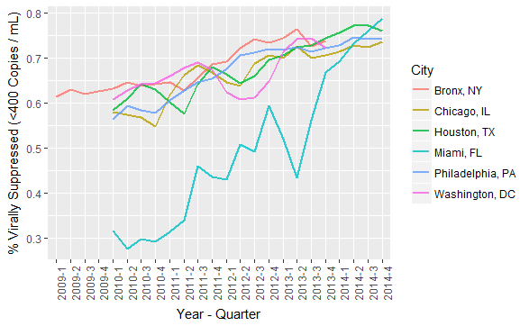
Example: TLC-Plus Viral suppression assessment
Notes:
Viral suppression: All diagnosed HIV-patients included: missing VL treated as NS
Failure to upload lab evaluations lead to lower Viral Suppression.
Miami: Consitent issue with low number of assessments in the eHARS system
Washington DC: 4 quarters where viral loads from one DC lab were only being partially captured, affecting 6 DC clinics.

Slide 17
Participation in cluster evaluation: Representativeness and risk of ascertainment bias
Exempt research: TLC-Plus
Theoretically: all tests for all diagnosed PLHV
Practically:
Failure to link individual records likely not biased.
Passive surveillance has risk of systematic failures that can bias results
Required research consent: HPTN 071 and HPTN 043
“Non-response” bias high in household recruitment setting.
Project Accept: ~83% participation rate; 46% men
PopART: ~ 65% participation rate; 29% men
Intervention participation (Coverage)
Project Accept : 52-58% participating were men
PopART: 56-67% of men; 71-86% of women

Slide 18
Evaluation issues: Power
Power/Sample size based on equal weight of communities
Enrollment below expectation in 9 of 21 communities
Solution: Continue recruitment “Open cohort”
Add new enrollments during 12 month round
Retention ~ 70% retained at first annual visit
Add new enrollments during 24 month round (Arms A and C only)
Impact on measuring the impact of PopART in the community
Assuming treatment-as-prevention is primary mechanism
HIV-uninfected person enrolled after one year is experiencing the full benefit of the intervention by living in a community with lower viral load
Ameliorate effect of aging of cohort
Notes:
AFOr all CRTs, power pretty much determined by the number of communities participating.
dditional advantage that ameliorate the aging of the cohort: Logic: measuring the impact of TasP in the community – anyone you enroll after one year to measure the effect is experiencing the full benefit of the intervention

Slide 19
Evaluation issues: Timing
Intervention effect
Time for intervention to affect primary outcome; magnitude of effect
Project Accept: Evaluate at the end of the intervention. Assessed change in all persons in household 18-32 yo.
PopART : Change from evaluating all three years to evaluating in only the second and third years (over last 24 months).
TLC-Plus: Evaluation period began 9 months after initiation of financial incentives (over last 15 months)
Notes:
All trials ended up allowing time for the intervention to achieve a stronger effect – balance between power from more endpoints and size of effect. Opted for size of effect.
End of study evaluation meant did not have to concerned about hawthorene effect – all people in HH; PopART needed to stay with single person because of intervention

Slide 20
Hawthorne effect in HPTN 071 (PopART)
HIV incidence:
Impact of participation in the measurement cohort
Increased access to testing
Increased detection of undiagnosed HIV+
Increased ART
Little risk to HIV incidence endpoint
Test HIV negative
Potential impact on viral suppression endpoint in measurement cohort
Test HIV-positive

Slide 21
Hawthorne effect in HPTN 071 (PopART)
Assess impact of participation in HIV+ in the measurement cohort by comparison of rapid test uptake.
Increased access to testing
Increased detection of undiagnosed HIV+
Increased ART in measurement cohort
Little risk to HIV incidence endpoint
Test HIV negative
Potential impact on viral suppression endpoint in measurement cohort
Test HIV-positive
 | Arm A | Arm B | Standard of care
Uptake of Rapid test: All HIV infected
Baseline | 16% | 13% | 19%
1 year | 9% | 7% | 14%
2 year | 5% | 4% | 12%
Uptake of Rapid test: HIV infected do not self-report HIV+
Baseline | 25% | 21% | 32%
1 year | 19% | 13% | 22%
2 year | 13% | 10% | 34%
Increase in cumulative HIV knowledge (self-report of HIV+ at current or prior visits)
Baseline | 64% | 65% | 65%
1 year | 75% | 73% | 77%
2 year | 78% | 82% | 86%
Notes:
SOC arm – no HH testing; Arms A and B HH testing throughout the 3 years. Participation in measurement – delivery offer of rapid test to households for participant: was the uptake very different?

Slide 22
Evaluation issues: Contamination in assessment
PopART: Contamination with in- and out-migration from community
Concern from DSMB about ~30% follow-up each evaluation round
Measurement cohort is to capture the effect of the intervention on those living in the community
Relevant measure is captured only in those remaining in the community
TLC-Plus: Contamination with migration to FI clinics
Inclusion in the endpoint required “Established in care”
At least two visits, in two different calendar quarters
Individual-based intervention with clinic-based implementation
Notes:
From perspective of traditional RCTs, very prro retention would be a concern and every effort made to find and follw everyone recruited.

Slide 23
Risk of novel approach: Project Accept (2001 – 2011)
Primary endpoint: Cross-sectional recency assay
“In December 2005, the UNAIDS Reference Group on Estimates, Modeling and Projections issued a statement … BED-CEIA assay overestimated HIV incidence by misclassifying a number of individuals with long-term infection as recent infection in cross-sectional settings.”
Launched a project to validate a recency endpoint (2006-2011)
Achieve joint understanding in laboratory and statistical teams of evaluation problem
Compile a reference library of samples with known length of infection to test algorithms and assays in relevant clades (the basis of the CEPHIA working group)
Lab: assay test results for samples
Statistics: Simulations of assay combinations with lowest bias and highest power
Laeyendecker,AIDS 2012
Brookmeyer JAIDS 2013

Slide 24
5 years to define endpoint: Evaluation of power
Bootstrap simulation to evaluate bias and variance:
Three epidemic scenarios
403 combinations of 4 assays
8 entered final assessment
Power to detect a 35% decrease in incidence.
Algorithm | Estimated intervention effect (RR) | Std. error of log estimated RR | Power | Coverage of 95% conf. intervals
6-month follow-up | 0.631 | 0.182 | 70.4% | 94.7
BED<0.8 | 0.763 | 0.109 | 68.4% | 57.3
AI<40 | 0.705 | 0.165 | 56.5% | 88.8
BED<1.0, AI<80, CD4>200, VL>400 | 0.653 | 0.169 | 69.7% | 95.6
BED<1.2, AI<90, CD4>200, VL>400 | 0.663 | 0.157 | 75.5% | 93.1
BED = BED-CEIA; AI = Avidity index; VL = viral load

Slide 25
Lessons learned
Cluster randomized trials have many complex, moving parts
Cross-team meetings critical to collectively evaluate progress of all aspects of the trial
Team’s primary task to stay focused on intervention delivery and coverage
Statistician’s primary task to stay focused on primary endpoint evaluation
Are we measuring the right people, at the optimal time, with high completeness.
How are research operations affecting representativeness and power
Can we improve/change the measurement approach and still answer the question
Expect changes and challenges over the (long) course of operations
Creative solutions clearly addressing common goals, working together as a team: balancing operational/intervention and data/statistical perspectives
Proactive/timely monitoring of data important for finding problems and unexpected issues early

Slide 26
Strengths and challenges of cluster randomized trials
It is challenging to effect change across an entire community
High coverage x high effectiveness x rapid deployment
Set realistic effectiveness expectations
Resource intensive trials, designed to demonstrate modest effect sizes
Difficult to message success
Strengths
Choosing to demonstrate “population” effectiveness informs real-world challenges of scale-up and implementation
Trials bring real-world benefits to the communities

