Slide 1
Randomization: Beyond the Closurization Principle
Lawrence H. Moulton
University of Pennsylvania
12 April 2021

Slide 2
The issues discussed today are very much the same for randomization of any study that has a small number of randomization units. Thus, much of what is said here is applicable more generally.
Detailed outline:
Why randomize?
How to randomize?

Slide 3
Why Do We Randomize?
Avoid bias by investigator in treatment allocation.
Avoid the appearance of bias on the part of the investigator.
Attempt to achieve balance on identified potential confounders.
Attempt to achieve balance on unidentified potential confounders.
Help ensure masking (blinding).
By-product: convenient way to assign treatments.
A minority position among statisticians is that randomization is necessary for statistical inference. But for most of us, it is the clusters’ outcomes that are the random variables.

Slide 4
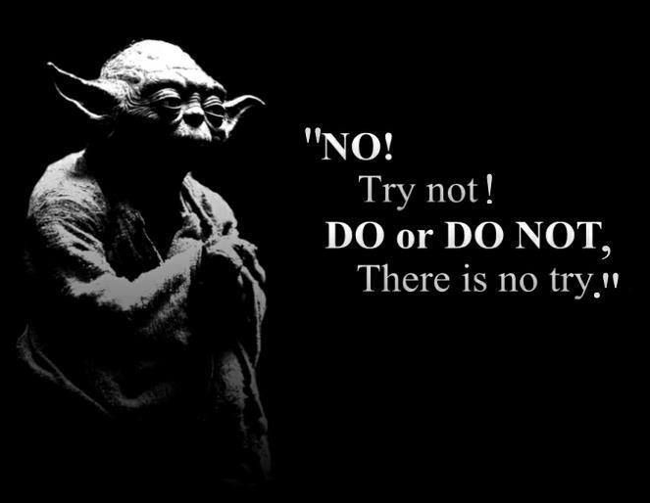
But we want to do better than “attempt” to achieve balance!
From The Empire Strikes Back

Slide 5
How Can We Avoid Bad Luck?
Once the sample size and stratification design and randomization units are decided upon, we can go ahead and randomize. But how can we avoid bad luck?
One way might be to perform a separate randomization within each stratum—this raises the probability that the study arms will be nearly balanced with respect to the stratification variables.
However, there are two problems with this: we may not be able to stratify on enough variables, and we can still have bad luck!

Slide 6
Stratification: if formed from 10 baseline covariates, each say dichotomized at the median, then have 2^10 = 1024 potential strata—but with only 20 clusters to randomize, can’t handle this!
Bad luck: in CRTs, typically have a small number of clusters; but still have a lot of covariates, greatly increasing the chance of an imbalance that would not look good in a ‘Table 1’

Slide 7
Of course, we could subscribe to the closurization principle—that after the randomization, it is OK to ignore which particular allocation was chosen—i.e. OK to ‘close ur eyes.’
(Royall, AJE 1976 “Current advances in sampling theory:
implications for human observational studies”)
But, do you really want to do this with a $20 million study, one that will never be done again?
Best to think really hard, up front, about all the randomization results that would make you unhappy!

Slide 8
Let’s take a step back…what are desirable criteria for a randomized study?
Want the randomization to be unbiased
Want the randomization to be valid
Want the results to be balanced on relevant baseline covariates
We can restrict the randomization to achieve balance, or near-balance—but at what cost?
Next—what is meant by unbiased and valid?

Slide 9
Unbiased: means each randomization unit has the same chance to be selected for a treatment arm as any other unit.
More formally: A design is unbiased if the expected value (over all possible randomisation outcomes) of the difference in treatment means is equal to the true difference.

Slide 10
Valid: in a completely (simple) randomized design, the design is valid if each pair of randomization units has the same probability of being allocated
the same treatment.
More formally: "scheme is said to be valid if the expectations of the treatment mean square and the error mean square are equal in the absence of treatment effects" (Bailey, 1987 JASA; Bailey & Rowley, 1987 JRSSA).

Slide 11
Everyone is familiar with unbiasedness, which deals with means (first moment considerations). Validity, which deals with variances (second moment considerations), is another matter.
Validity refers to the ‘unlinkedness’ of experimental units, i.e. to the correlation of treatment assignment to them.

Slide 12
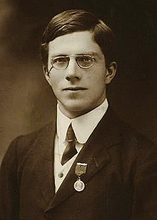
Of course—it all goes back to Fisher!
(as noted by Bailey)
R.A. Fisher gave as an example an agricultural experiment in which there are 15 pots, each with a West side and an East side, and each pot is to have one plant of type A in it, and one of type B, to see which type grows highest.
( Fisher—Design of Experiments 4th Edn 1947 New York:Hafner)
If a coin is flipped for each pot (each pair) to see
which side the A or B plant is to be placed, the
experiment’s randomization is both unbiased and
valid.
But suppose we try an alternative randomization
strategy…

Slide 13
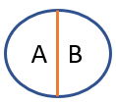
If just one coin flip is made, with the result: if heads, put type A plants in the West side of each of the pots, and if tails, put type A plants in all the East pot sides--still results in an unbiased randomization.
But it is not valid—all those on the West side are always in the same study arm, i.e. their treatment assignments are completely correlated.
And not very satisfactory—the East side may
get good sun, the West side might be shaded.
(Note: this outcome could also arise from bad luck even if each pair randomized separately!)
.
.
.

Slide 14
Ridiculously small example…
HIV vaccine study in 4 villages,
with baseline HIV prevalences (%):
(2, 4, 10, 12)
If don’t constrain the randomization, is unbiased
and valid, but have a 2/3 chance of imbalance,
and a 1/3 chance of all vaccine villages having
highest, or lowest, prevalences.

Slide 15
All 4-choose-2 Potential Allocations (prevalence % stands for village label)
Mean
Allocation Vaccine Control Diff (equal popn say)
A 2 4 10 12 -8
B 2 10 4 12 -2
C 2 12 4 10 0
D 4 10 2 12 0
E 4 12 2 10 2
F 10 12 2 4 8
Note: allocations A and F have all vaccine villages with highest, or lowest,
prevalences.

Slide 16
What else this implies…
In fact, we have only a 1/3 chance of getting perfect balance on HIV prevalence.
Constraining the randomization to C & D, i.e. just saying “I’ll only choose between C & D, will flip a coin to decide”,
is NOT VALID, because for example, 2 & 10 are never on the same arm, and 2 and 12 are always linked together.
Mean
Allocation Vaccine Control Diff
A 2 4 10 12 8
B 2 10 4 12 2
C 2 12 4 10 0
D 4 10 2 12 0
E 4 12 2 10 2
F 10 12 2 4 8
We may as well think of
2 and 12 as making up one
randomization unit!
(likewise for 4 and 10)

Slide 17
Tradeoff
Want to constrain enough so that ensure marginal balance on relevant covariates—like minimization technique for balancing trials with sequential enrollment except do it all up front
Don’t want to constrain so much that validity (independence) is lost, setting one up for criticism, and possibly increasing Type I error

Slide 18
Algorithm for highly restricted randomization
Form a list of all possible randomization outcomes
Making a pass through these, select those that meet the specified minimization criteria (balance, or near-balance on set of covariates)
Check degree of validity of design; can make matrix showing number of times all pairs have the chance to be together from among those identified in step 2)
Accept and go to 5), or lighten up or tighten up criteria and go back to 2); or change the stratification, go to 1)
Randomly select one randomization from among the acceptable ones identified in step 2)
Moulton, 2004 Clinical Trials

Slide 19
Implementation of highly restricted randomization
We have a SAS macro that can handle small numbers of clusters. Better ones are by E.J. Greene (J.Statistical Software 77 code Snippet 1, 2017): https://github.com/ejgreene/ccr-sas
and Lorenz&Gabrysch: ccrand Stata routine (Stata J 17:2;503-510).
I have found that it is almost impossible to pre-program this approach to handle all the variations one is faced with. So, special-purpose programming in a lower-level language becomes the easiest way to do it, using existing subroutines for random permutations and listing of all combinations.
Modification for larger numbers of clusters (say, 20 in each arm, which has 137,846,528,820 potential allocations): instead of listing all possible randomization outcomes, randomly sample from them, say a million times, and apply the constraining criteria to them.

Slide 20
Other methods are available
Some other methods balance an overall score, e.g.:
Raab, G. M. and I. Butcher. 2001. Balance in cluster
randomized trials. Statistics in Medicine 20: 351– 65.
(balance on weighted sum of covariate mean diffs)
Xu Z, Kalbfleisch JD B. Propensity score matching in
randomized clinical trials. 2010 Biometrics.
(balance on propensity score)
Or use the ‘big stick’ (Bruhn & MacKenzie, 2009 American Economic Journal) approach:
rerandomize until all Table 1 comparisons have P>0.05

Slide 21
Overview of methods with theoretical results:
Morgan, Kari Lock; Rubin, Donald B. Rerandomization to
improve covariate balance in experiments. The Annals of
Statistics 40 (2012), no. 2, 1263-1282
They propose Mahalanobis distance as a summary criterion,
and investigate some of its properties (and more generally, those that are affinely invariant transformations of the covariates); but do not look at relations to Fisher-Bailey validity.

Slide 22
However, these methods do not guarantee validity, which still must be checked; and without control of individual variables, can still end up with undesirable imbalances.
Example: drug intervention study in Baltimore, randomizing 20 census tracts
Covariates for balancing: total population, family income, % vacant houses, % males employed, % high school education, % receiving Public Assistance, % 15-64 years of age, % African-American

Slide 23
Constrained using two methods:
univariate caliper—requiring each variable’s means in the two arms to be +/- p% of each other (ended up as +/- 13.04%)
2) Mahalanobis distance based on all the variables
Each criterion, p and summary distance, made progressively tighter until exactly 499 acceptable unique allocations were found with each method.

Slide 24
Min and max of ratios of means of variables in each arm
 | Univ Caliper Min | Mahalan-obis Min | Univ Caliper Max | Mahalan-obis Max
Total popn | 0.886 | 0.853 | 1.13 | 1.17
Fam income | 0.885 | 0.843 | 1.13 | 1.19
Vac houses | 0.885 | 0.529 | 1.13 | 1.89
Males empl | 0.926 | 0.942 | 1.08 | 1.06
HS ed | 0.885 | 0.884 | 1.13 | 1.13
Recv Pub Asst | 0.885 | 0.735 | 1.13 | 1.36
15-64 yr old | 0.958 | 0.963 | 1.04 | 1.04
African-Am | 0.885 | 0.640 | 1.13 | 1.56
Notes:
NOTE: run again, to get caliper more valid than maha; see if caliper has to be as loose as maha to get that.

Slide 25
Out of 499 potential allocations:
Univ Caliper min , max # times pairs of units in same arm: 19, 497
Mahalanobis min, max # times pairs of units in same arm: 87, 425
Mahalanobis criterion allows some big “Table 1” differences; but is somewhat more “valid”
Of course, in practice, with the univariate caliper approach, we can loosen a couple of the constraints, and tighten others, to avoid the above pairwise inclusion extremes.
If we loosen the Mahalanobis criterion, the validity would also improve, but we would increase the potential to have even larger Table 1 differences.

Slide 26
Yet another approach favored by a few (perhaps more…) economists: Optimization (“Be an Optimista, not a Randomista”) –just take the best allocation!
https://blogs.worldbank.org/impactevaluations/be-optimista-not-randomista-when-you-have-small-samples
Bertsimas et al.: The Power of Optimization Over Randomization. Operations Research 2015
Kapelner et al.: Harmonizing Optimized Designs With Classic Randomization in Experiments. The American Statistician 2020

Slide 27
Note on this Optimista approach, which finds the best allocation, then “flips a coin” to determine which arm gets which treatment:
It is unbiased, has some advantages, although clearly it is not valid. And, a randomization analysis is not possible, although a similar bootstrap-based method could be used.
However, it can be justified under a Bayesian argument (“Why Experimenters Might Not always Want to Randomize, and What They Could Do Instead”
Kasy, Political Analysis 2016.)
Problem for (?)-> Avoid the appearance of bias on the part of the investigator.
Notes:
How? Condition on the ancillary statistic of the randomization outcome. As in likelihood inference.

Slide 28
Turns out, for once, the economists were beat out by the biostatisticians:
The ‘‘best balance’’ allocation led to optimal balance in
cluster-controlled trials. De Hoopa, et al. 2012 J Clin Epi
credits:
Studywise minimization: A treatment allocation method that improves balance among treatment groups and makes allocation unpredictable. Perry, et al. 2010 J Clin Epi
with having come up with the idea:
Find the set of allocations that minimizes the imbalance, then randomly choose one of those. They don’t mention that the set may consist of 1!

Slide 29
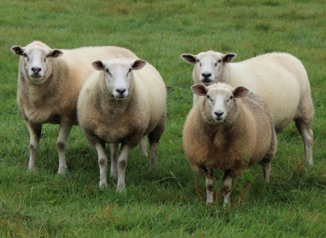
But enough of all that… revenons à nos mou(l)tons!
(let’s get back to the matter at hand!)

Slide 30
What can be the effects of a non-valid design on its frequentist properties?
This can be a problem when there is correlation among units, which can arise in many geographically-related ways in group-randomized trials.
If a set of constraints results in, say, a pair of units being together in the same arm 90% of the time, then have effectively lost a d.f. if their responses are also highly (positively) correlated. If we analyze assuming N units, but really only have N-1, then Type I error is slightly inflated.
But even in fairly extreme situations, only from 0.05 to 0.07 or so. Still, we would want to check validity, to avoid a rise to as much as 0.07.

Slide 31
So:
If we want balance on a bunch of covariates, we can constrain the randomization space.
If we do so, and we want to use the full array of analysis methods, need to check for near-validity.
Else, we must use randomization-test based analyses; or, regressing on the constraining covariates can help (Li F et al. 2017 Stat Med)

Slide 32
Lagniappe By the way…more research needed on how to constrain randomization of stepped wedge designs:
What balancing criterion to use?
Moulton et al. (Clinical Trials 2007) used
covariate-weighted months in control vs. intervention
phase, but there must be something better.
How to test for validity?
e.g. examine # times a pair of units enter
intervention phase together, or within 1 step of each
other.

Slide 33
Summary
1. We are always subject to the possibility of bad luck
2. The cause is small numbers of randomization units and lots of known and unknown potential confounders
3. We can constrain the randomization to minimize the maximum loss
4. Unless using only randomization analyses, should check to see if have overconstrained (loss of Fisher-Bailey validity)

