Slide 1
Regulatory Perspective of the Use of EHRs in RCTs
Mark Levenson, Ph.D.
Office of Biostatistics
Center for Drug Evaluation and Research
U.S. Food and Drug Administration

Slide 2
Disclaimer
This talk reflects the views of the author and should not be construed to represent FDA’s views or policies.

Slide 3
FDA Definitions
Real World Data (RWD) are data relating to patient health status and/or the delivery of health care routinely collected from a variety of sources.
electronic health records (EHRs)
Real World Evidence (RWE) is the clinical evidence regarding the usage and potential benefits or risks of a medical product derived from analysis of RWD.
Generated using many different study designs, including but not limited to, randomized trials, such as large simple trials, pragmatic clinical trials, and observational studies.
claims and billing data
data from product and disease registries
patient-generated data including in home-use settings
data gathered from other sources that can inform on health status, such as mobile devices

Slide 4
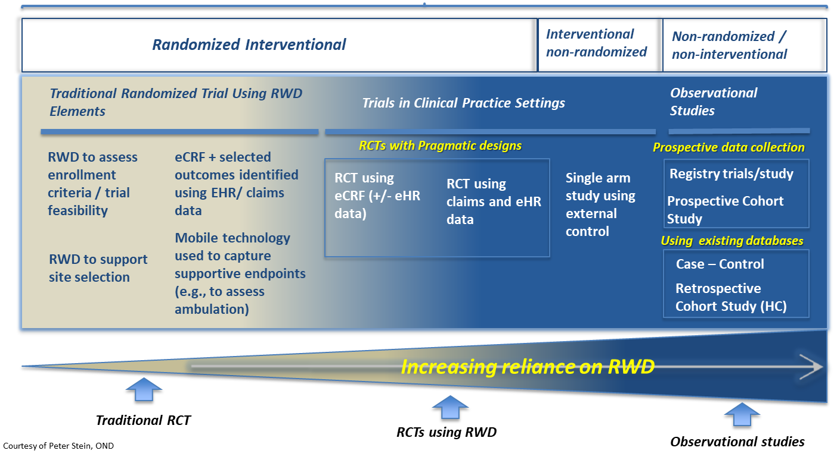
Spectrum of Potential Uses of
Real-World Data

Slide 5
RWD/RWE: What Are the Goals?
Traditional RCTs typically
Use select groups of patients
Involve special infrastructure and data collection
Maximized sensitivity
RWD/RWE Goals
Reflect the diversity of patients and actual health-care practices
Improve efficiency by making use of existing data and infrastructure
Maintain evidentiary standards

Slide 6
PRECIS-2 Tool: Loudon et al., BMJ 2015

Slide 9
RWE Give and Take
Real Patients and Healthcare
Efficiency

Slide 10
Substantial Evidence Efficacy
“evidence consisting of adequate and well-controlled investigations, including clinical investigations, by experts qualified by scientific training and experience to evaluate the effectiveness of the drug involve on the basis of which it could fairly and responsibly be concluded by such experts that the drug will have the effect it purports or is represented to have under the conditions of use prescribed, recommended, or suggested in the labeling or proposed labeling thereof.”
Federal Food, Drug, and Cosmetic Act 1962
Drug Regulation History: https://www.fda.gov/AboutFDA/History/ProductRegulation/ucm593465.htm

Slide 11
Adequate and Well-Controlled Study
Reserved for special circumstances
Clear objectives, summary of methods and results
Design permits a valid comparison with a control (concurrent and historical controls)
Adequate selection of patients
Assigning patients to treatment and control groups minimizes bias
Adequate measures to minimize biases on subjects, observers, and analysts
Well-defined and reliable assessment of subjects’ responses
Adequate analysis to assess drug results
Ordinarily randomization
Blinding
Regulations 21CFR314.126

Slide 12
21st Century Cures Act (2016)
establish a program to evaluate the potential use of real world evidence-
  to help to support the approval of a new indication for a drug approved under section 355(c) of this title; and
  to help to support or satisfy postapproval study requirements.
No change in
evidentiary standard
SEC. 505F. UTILIZING REAL WORLD EVIDENCE. Amended by Food and Drug Administration Reauthorization Act 2017

Slide 13
Intended for drug and biological products
Outlines FDA’s plan to implement the RWE program
Multifaceted program
  Internal processes
  Guidance development
  Stakeholder engagement
  Demonstration projects
https://www.fda.gov/downloads/ScienceResearch/SpecialTopics/RealWorldEvidence/UCM627769.pdf

Slide 14
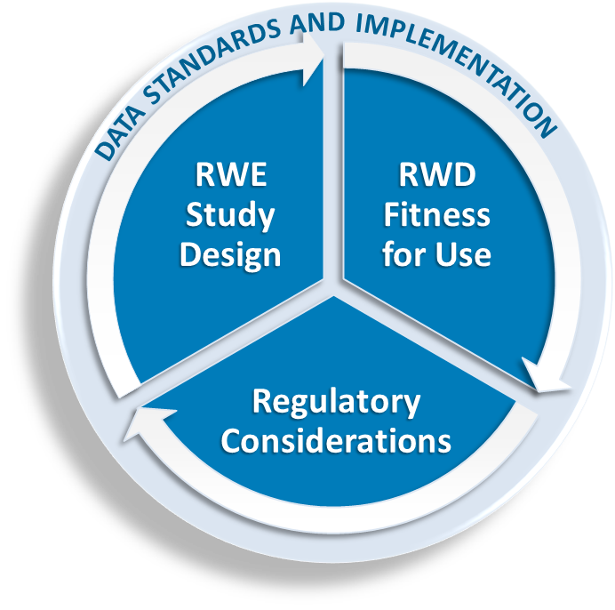
Framework for Evaluating RWD/RWE for Use in Regulatory Decisions

Slide 15
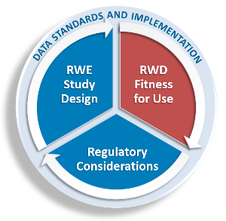
RWD Fitness for Use
Data uses
  Population selection
  Outcome ascertainment
  Safety and study monitoring
Data reliability, validity, relevance
Multiple data sources may be needed

Slide 16
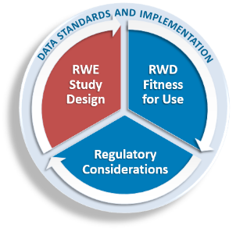
RWE Study Design
Population selection
Comparator groups
Outcome ascertainment, blinding
Exposures patterns, dropouts
Treatment definition (estimand)
Hypothesis (eg, non-inferiority)

Slide 17
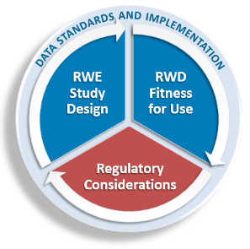
Regulatory Considerations
Human subject protection
Data traceability, auditing, and record keeping
Safety reporting
Study integrity and responsibility

Slide 18
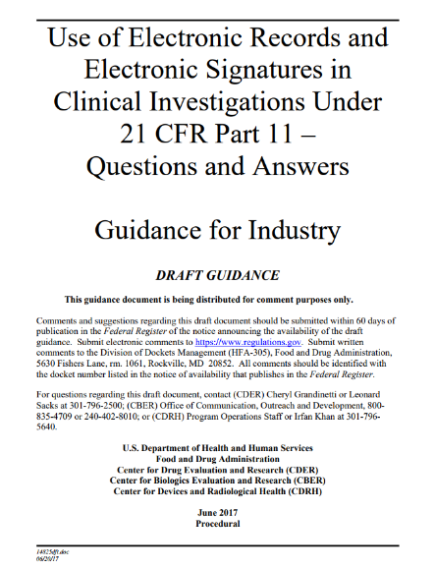
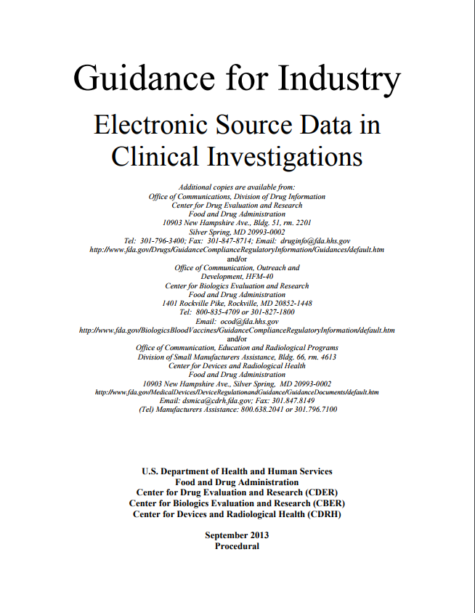
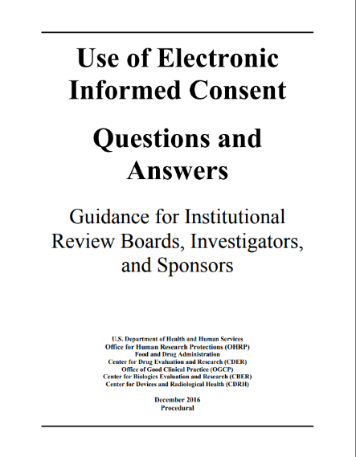
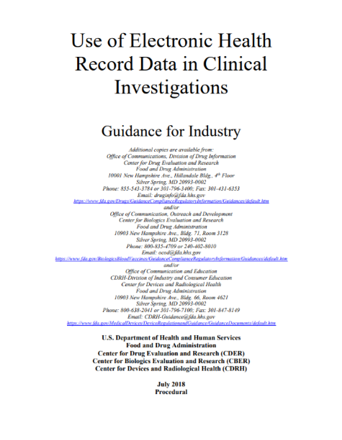
Foundation for Use of
Electronic Source Data

Slide 20
Final Thoughts
EHR use is not synonymous with pragmatic
Data fitness, study design, and regulatory issues should be considered
Multiple sources of data may be needed
How and when EHR/RWD/RWE may provide strong evidence is under development

Slide 21
Acknowledgements
Jacqueline Corrigan-Curay
Robert Temple

Slide 22
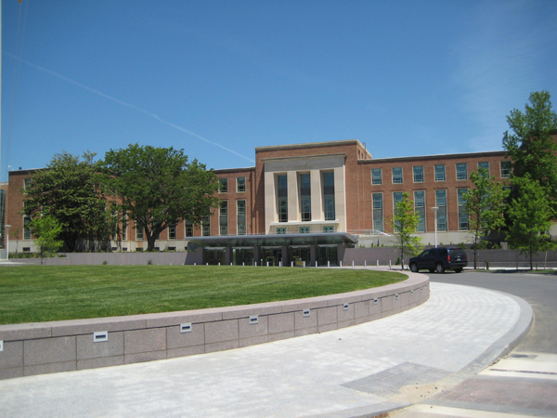
Thank you mark.levenson@fda.hhs.gov

